Slide 1
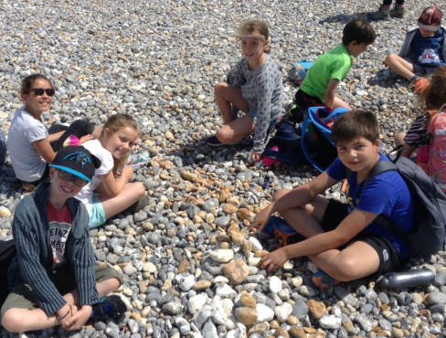
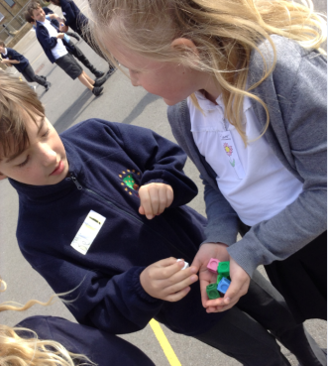
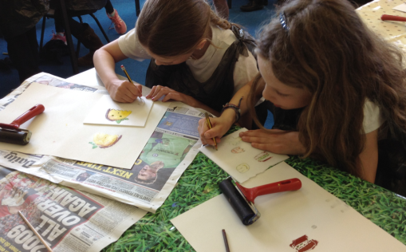
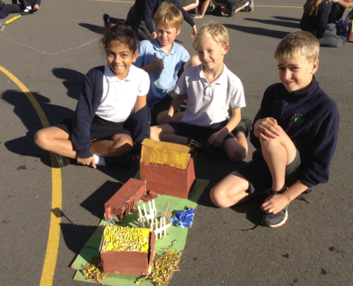
Balfour Primary School
Year Four Parent Workshop
Thursday 10th October 2019

Slide 2
Welcome to Year 4
The Year 4 Team
Year Leader – Mrs Porter – Oxide Class
Miss Hobson – Orbit Class
Ms Miah – Oxygen Class
Miss Kenward – Orion Class
Teaching Assistants
Miss Penn, Mrs Skinner, Mr Barton

Slide 3




Topics
Autumn Term – Invaders and Settlers
Spring Term – Tombs and Treasures
Summer Term – Flowing and Growing

Slide 4
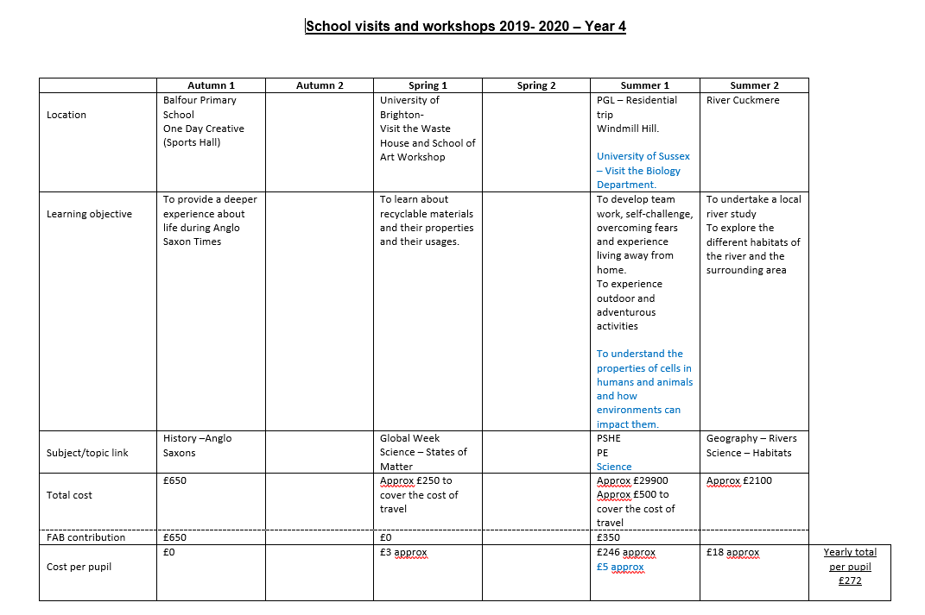
Learning Experiences

Slide 5
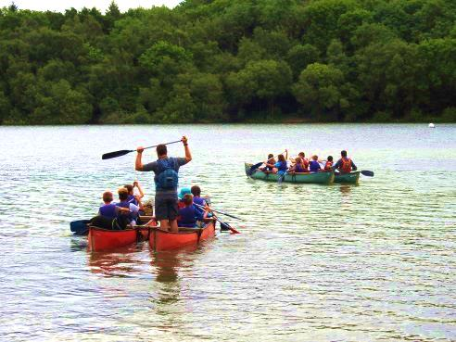
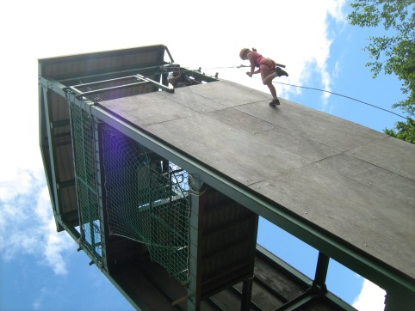
Residential Trips
Residential trips are an
extraordinary opportunity for
the children and the kids love them!
These trips are not part of the national curriculum, part of a syllabus for a prescribed examination or part of religious education; and they include board and lodgings – therefore they are optional and payment is compulsory. (DfE (2018) ‘Charging for school activities’, p. 5)
Financial difficulties? The school could help but you must speak to a member of SLT before October half term.
If your child doesn’t attend they’ll have alternative provision provided at the school.

Slide 6
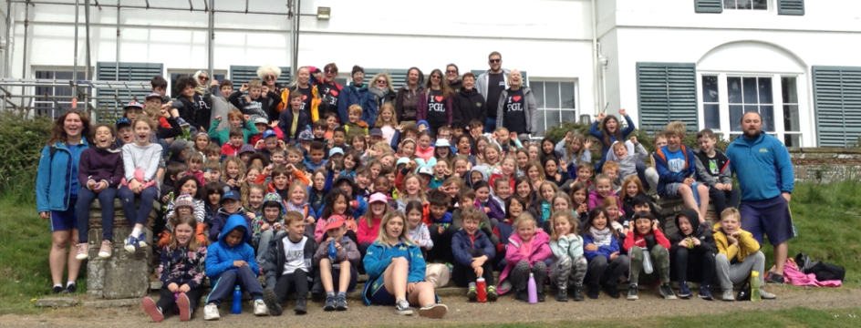
PGL
In the Summer Term we are planning to have a 3 day/ 2 night adventure trip to Windmill Hill.
The cost of this trip will be £246.
The payments will be broken down into instalments across the next 3 terms.

Slide 7
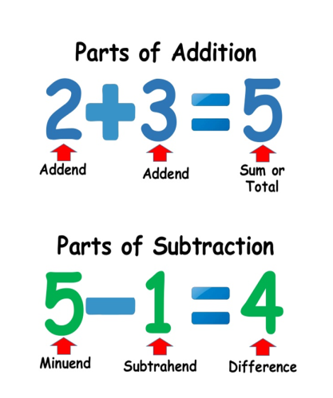
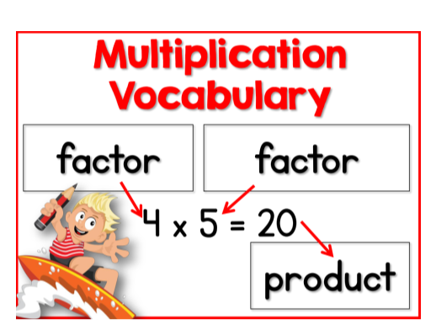
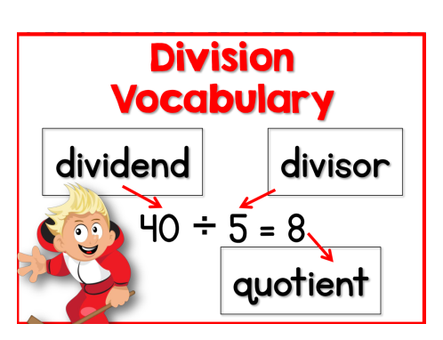
How we teach Maths
5 planned and differentiated lessons per week
Maths Masterclasses 3 times per week focussing on areas of development and extra challenge.
Most children receive feedback during the lesson, allow for instant addressing of misconceptions or challenging of thinking.

Slide 8
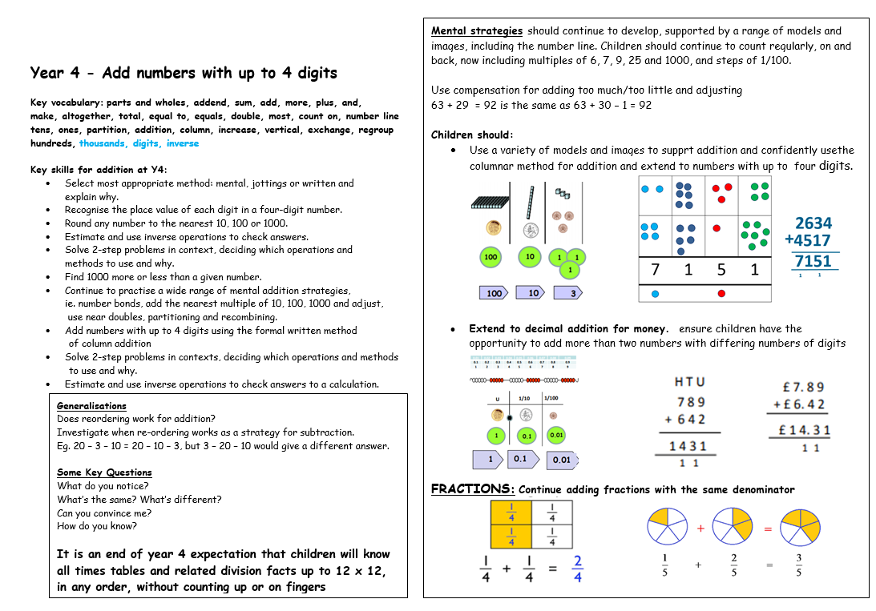
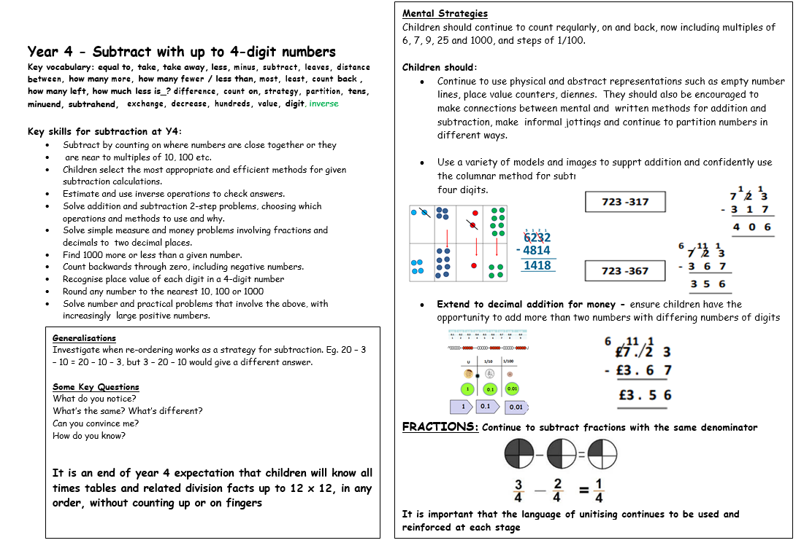
Year Four Maths Methods

Slide 9
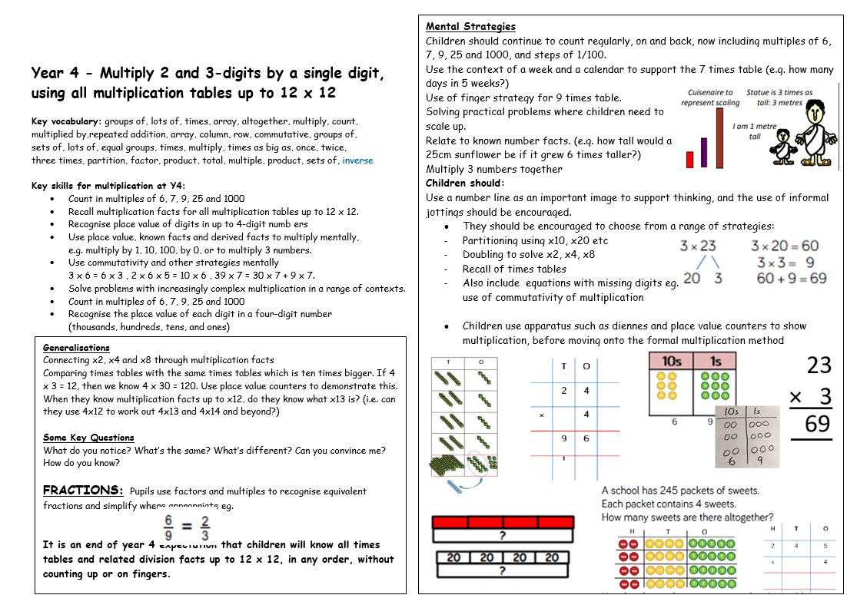
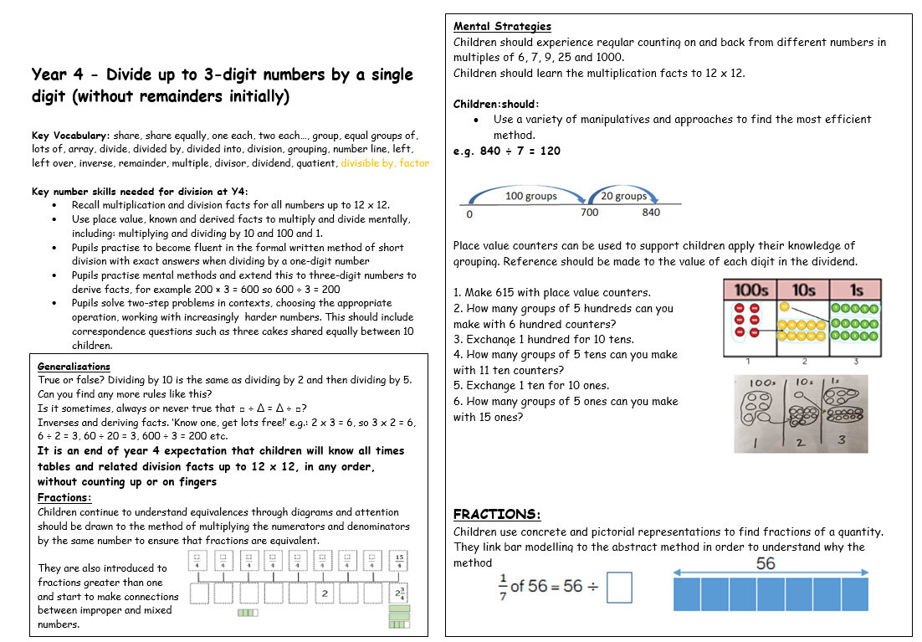
Year Four Maths Methods

Slide 10
How do we assess the children?
Extended Writing Opportunities
Half termly Maths assessments
Half termly Reading assessments
Moderation across the Year Group
Live Marking
Use of Age Related Expectation descriptors.
Children are assessed using a range of the above, rather than just on a single test or a single piece of work.

Slide 11
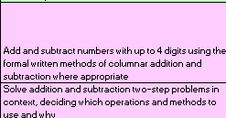
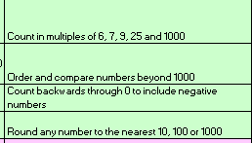
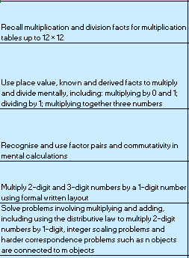
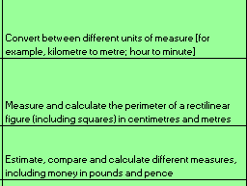
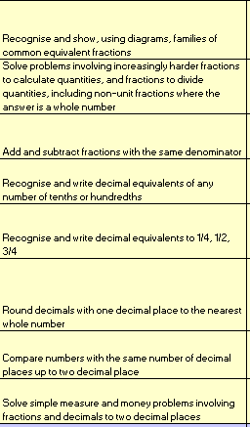
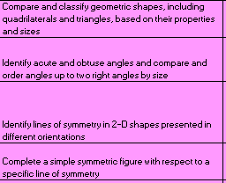

Maths
We assess the children in 7 areas.
Place Value, Addition and Subtraction,
Multiplication and Division, Fractions and
Decimals, Measurement , Geometry
And Statistics

Slide 12
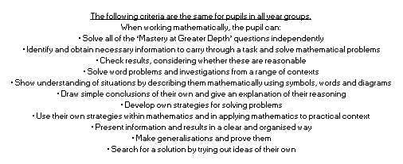
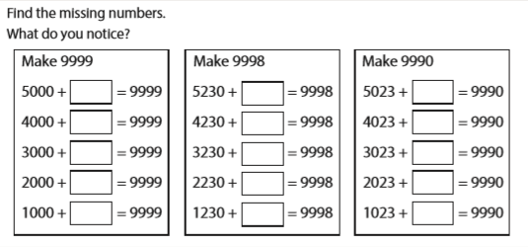
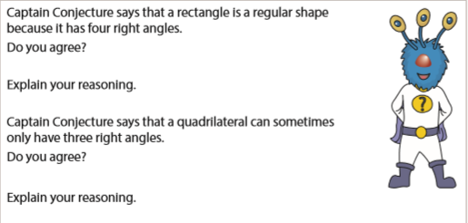
Maths
Examples of Greater Depth questions

Slide 13
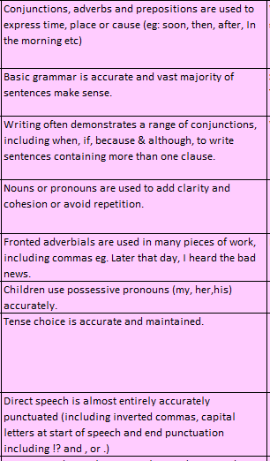
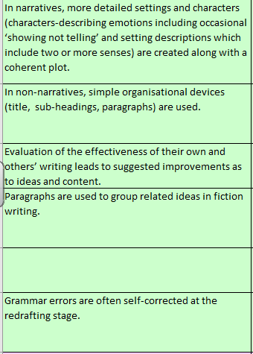
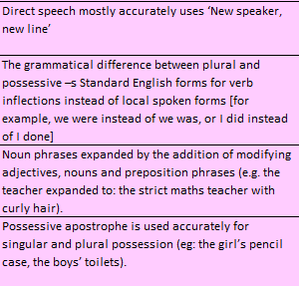
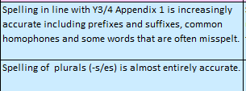

Writing at Year Four Level
We assess 4 areas in writing;-
Text Level, Sentence Level, Spelling and
Handwriting.

Slide 14
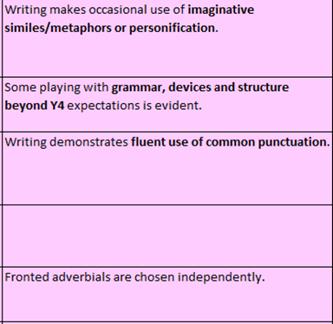
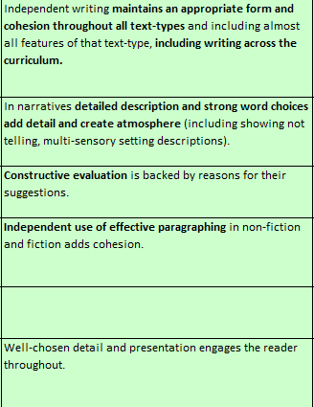
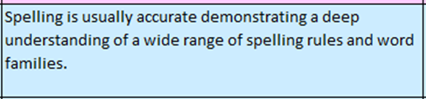
Writing at Greater Depth
If your child is working
above a Year Four
Level this is what
we assess against.

Slide 15
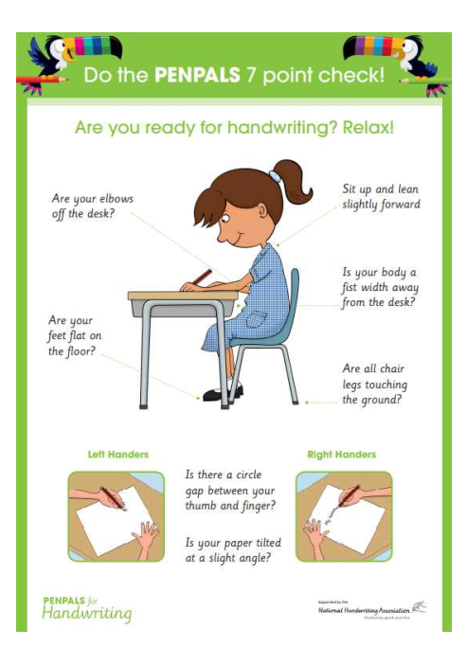
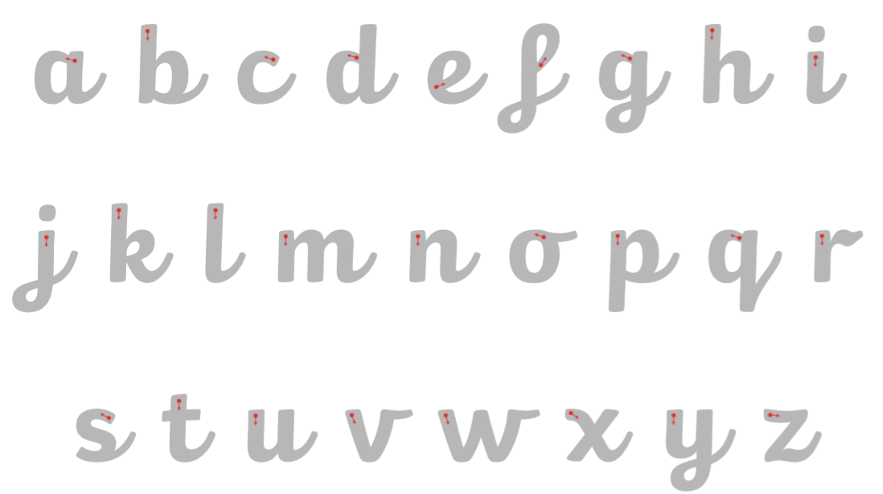
Handwriting

Slide 16
Home Learning
Home Learning is set on a Friday and due in on the following Wednesday.
We alternate between English and Maths.
Spread out across the year there will be longer projects set that are linked to the topics.

Slide 17
How to support your child at home
Reading
All reading is valuable – it doesn’t have to be just stories. Reading can involve anything from fiction and non-fiction, poetry, newspapers, magazines, football programmes, TV guides.
It is really important that you ask your child to read aloud you. This helps develop their intonation and expression.
Talk about your child’s reading – if they are reading a novel discuss the plot, the characters, their feelings and actions, how it makes you feel, predict what will happen and encourage your child to have their own opinions.
Look up definitions of words together – you could use a dictionary, the internet or an app on a phone or tablet.

Slide 18
How to support your child at home
Writing
Encourage opportunities for writing such as letters to family or friends, shopping lists, notes or reminders, stories or poems and write together
Encourage use of a dictionary to check spelling and a thesaurus to find synonyms and expand vocabulary.
Remember that good readers become good writers! Identify good writing features when reading (e.g. vocabulary, sentence structure, punctuation).

Slide 19
How to support your child at home
Maths
MATHLETICS and Times Table Rockstars
Practise times tables
Practise counting in different amounts such as fractions, decimals, negative numbers
Encourage opportunities for telling the time and making calculations around duration and how long things last.
Use timetables and schedules for buses, trains and TV programmes
Encourage opportunities to use money and budgeting
Identify, weigh or measure quantities and amounts in the kitchen or in recipes.
Play games involving numbers or logic, such as dominoes, card games, darts, draughts or chess.

Slide 20
Any Questions?

