Slide 1


Welcome to Year 3
2021-2022
We aim to make this an exciting, memorable and rewarding year at school for your child!

Slide 2
Balfour Class Names
Year R – Bugs
Year 1 – Animals
Year 2 – Trees and Plants
Year 3 – Nature
Year 4 – Science
Year 5 – Countries
Year 6 - Snakes
All of the Year groups chose a theme and named classes using the letter they had been given.
B
A
L
F
O
U
R

Slide 3
B – Bugs/Beetles/Bumblebees
A – Armadillos/Alpacas/Anteaters/Aardvarks
L – Lotus Flower/Laurel/Lavender/Lemon Tree
F – Fern/Forest/Fossil/Feather
O – Oxide/Orbit/Orion/Oxygen
U – Uganda/Ukraine/USA/Uruguay
R – River Jacks/Red Vipers/Rattlesnakes/Racers

Slide 4
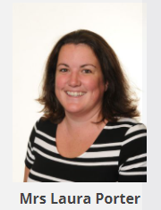
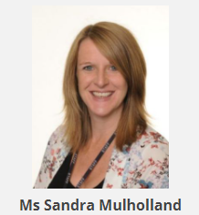
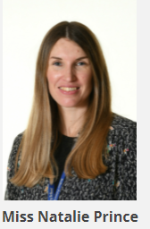
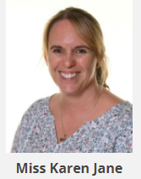
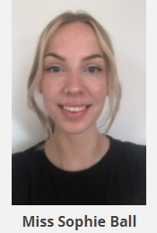
The Year 3 Team
Mrs Laura Porter– Year Leader & Fern Class Teacher
Miss Sandra Mulholland and Miss Prince- Forest Class teachers
Miss Sophie Ball– Feather Class Teacher
Miss Karen Jane– Fossil Class teacher

Slide 5
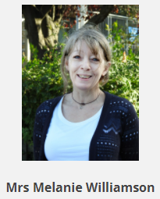
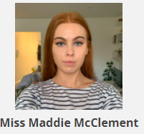
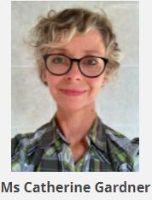
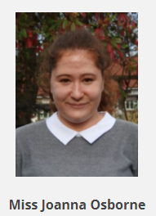
The Year 3 Team
Mrs Mel Williamson– Teaching Assistant
Miss Maddie McClement– Teaching Assistant
Ms Catherine Gardener-Teaching Assistant
Miss Jo Osbourne – 1 2 1 Teaching Assistant

Slide 6
Routines
Children line up at 8.55 and the teachers bring them in.
Children order their lunches with teacher
Children complete ‘early work’ before beginning lessons.
RWI
Maths and RWI usually taught in the mornings, Foundation subjects and science in the afternoons.
PE twice a week – children come in dressed for PE
Lunchtime – OPAL
Teacher contact – on the playground and email. Emergency messages please ring the office and a message will be delivered to the teacher.
PING – we use the school ping service to convey important messages across the year group. Please check regularly. Trip consent forms and parents evening appointments are also via PING.
Going home arrangements – please inform class teacher if there are any after school clubs or unusual going home arrangements (Play dates etc.)
Swimming in the Summer term.

Slide 7

Our Expectations
High expectations of behaviour
Growth Learning Climate
Quality work
Neat handwriting
Teacher marking with ways forward
Self assessment of their work
Peer assessment
Homework

Slide 8
Year 3 Topics
Autumn 1
Beside the Sea
Geography
Autumn 2
Brilliant Brighton
History
Spring 1
Fire and Flint
History
Spring 2
An Italian Adventure
Geography
Summer 1
Rampaging Romans
History
Summer 2
Active Planet
Geography

Slide 9
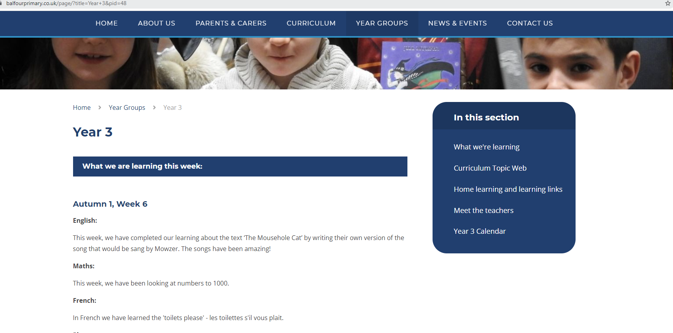

More Information
www.balfourprimary.co.uk

Slide 10

Read Write Inc. (RWI)
https://www.youtube.com/watch?v=sjlPILhk7bQ
RWI works on the principle of ensuring that your child’s phonics teacher knows the exact sounds to target through careful and regular phonic assessments
Children are assessed around every 5-6 weeks by a school assessor- who may not be your child’s class teacher but is most likely an adult within the school with whom they feel confident and comfortable around.
In order for us to target your child’s phonic level, following the assessments, your child will be put into a phonics group. It is important to note that your child’s phonics group may not by their class teacher. We use this approach to ensure that we can target the needs of the children and match their phonic level. However, it is important to emphasise that these groups are fluid and your child may move group depending on their progress.

Slide 11


Reading
A key change for the use of RWI and fundamental practise of home-learning support is that children will be sent home with a book or a book level that matches their phonic level
This means that your child should be able to fluently read the book that they are coming home with.
They would have been taught and focused on the sounds within that book during the week and should have secure previous phonic knowledge to support them in accurately reading the book
The aim of reading this book at home is for enjoyment and confidence building!
https://www.youtube.com/watch?v=kjHqJQ8sxs4&list=PLDe74j1F52zSCiOMSn3zQDSzgu9TrbQ1c&index=8
https://www.youtube.com/watch?v=iHMl70ZmxIQ&list=PLDe74j1F52zSCiOMSn3zQDSzgu9TrbQ1c&index=9

Slide 12

Year 3 - Maths

Slide 13
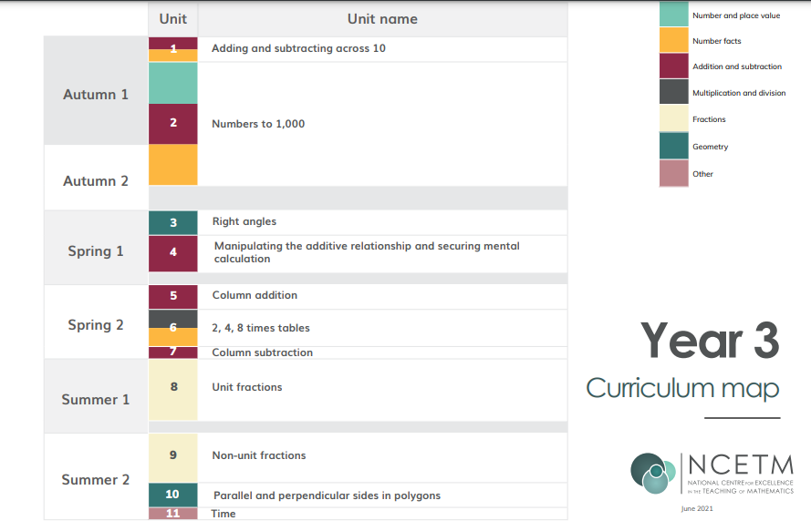
Maths Overview 2021- 2022

Slide 14



Maths at Home
https://www.youtube.com/watch?v=cIblA2drj_M
https://support.3plearning.com/mathletics/mathletics-parent-tour/
Your child has a log in
For both of these websites.
https://numbots.com/families/

Slide 15
FSM
If you were eligible for FSM, please ensure that you continue to keep the office informed.
We receive funding from every child that is FSM- this is used to pay for interventions and enrichment activities.
Please contact Sandramulholland@balfour.brighton-hove.sch.uk

Slide 16
Finally…
Any questions?
Please email your child’s teacher who will be happy to help.

