Slide 1
Reading Workshop
Wednesday 1st May 2024

Slide 2

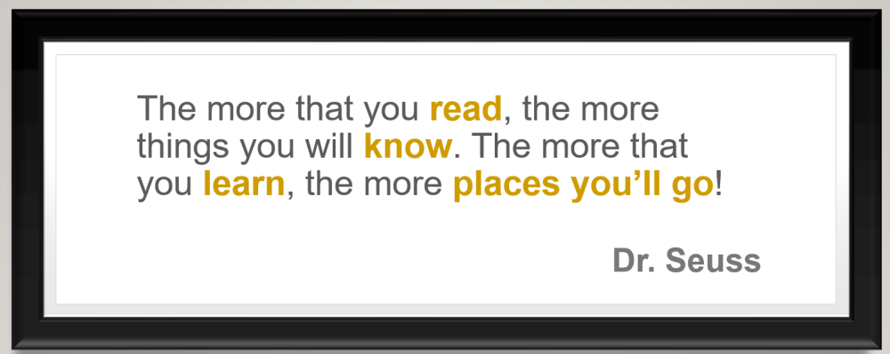

Slide 3
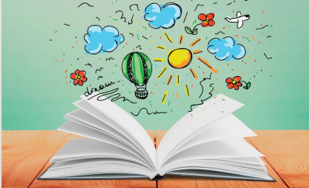
Reading in Key Stage 2
Children from Year 3 up to Year 6 continue to have reading at the centre of all their learning. Now that they can decode accurately and fluently, they build on from these strong foundation skills.
Children read independently, as a class and in all of their other foundation subjects (such as Geography, History, RE and Science).
Children have the opportunity for individual quiet reading every day, reading as a whole class, and being heard read by an adult in school every day should they require the additional support.

Slide 4
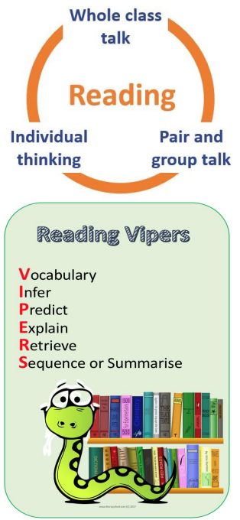
Whole Class Reading
Whole Class Reading is the lesson in which children in KS2 study specific texts and extracts from high quality books to learn and refine their skills in reading and comprehension.
Children use the 'VIPERS' framework to help break down the individual skills required to read and comprehend a text fully.
These skills are taught individually and build up over time throughout Key Stage 2, until children can read and comprehend fully and independently.

Slide 5

Prosody – Rhythm on the page
A prosody specific lesson is taught at least once a half term. This is where the children are taught how to reading with expression.
It has been shown that if a child with good expression tend to comprehend what they have read better.
This is what you are going to experience this morning within the classroom.

Slide 6

Reading Assessment
Children are assessed in their reading continually throughout the year.
We use standardised assessments each half term to gauge where your child is in their reading ability.
Children who require additional support in their reading will access interventions for further 1-1 adult support to help them keep up with their year group expectations.

Slide 7
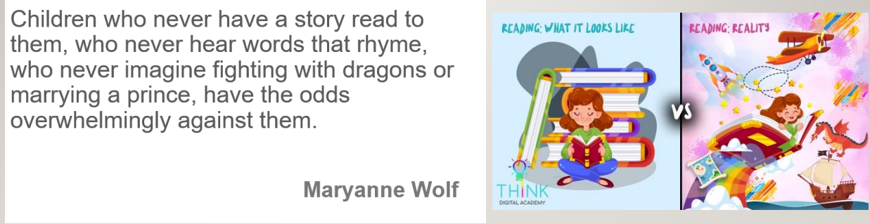
Reading at home
https://www.youtube.com/watch?v=xm7eZctoGag

Slide 8
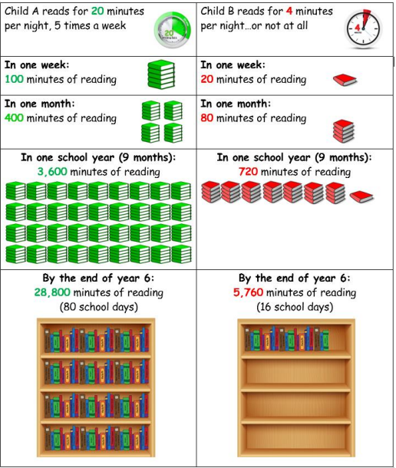

Why is it important to read at home?
Hearing your child read every day helps them with their decoding skills.
Reading stories to your children can help develop their love of reading and increases their vocabulary significantly.

Slide 9
10 things your child learns when you share in reading stories and poems:
1. Sustain attention.
2. Appreciate rhythm and rhyme.
3. Build pictures in their minds from the words on the page
4. Understand humour, irony and sarcasm.
5. Use new words and phrases in different contexts - and later in writing.
6. Learn new vocabulary and knowledge of the world.
7. Think about characters’ feelings and use appropriate voices.
8. Follow a plot with all its twists and turns.
9. Understand suspense and predict what’s about to happen next.
10. Link sentences and ideas from one passage to the next.

Slide 10
Top tips for storytimes
1.Make it a treat
2. Make it a special quiet time
3. Show curiosity
4. Read story once without stopping
5. Chat about the story
6. Avoid testing with questions
7. Link to other stories and experiences 8. Read favourites over and over again 9. Use different voices
10. Love the book – talk about what you loved most

Slide 11
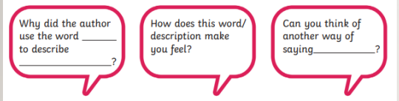
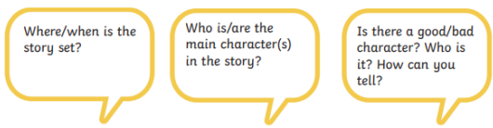
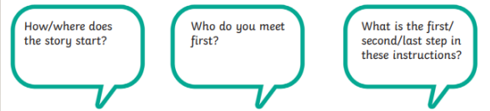
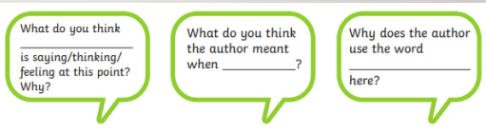
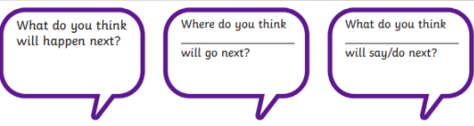
Example questions that build comprehension skills:

