Slide 1
Read Write Inc. Phonics
Information for Families
Balfour Primary School

Slide 2
What is phonics?
Sounds
m-a-t
sh-i-p
Graphemes
ai ay a-e a
Notes:
All words are made up of individual sounds. These sounds are merged together to form words.
e.g. in ‘mat’ we have the sounds ‘m’, ‘a’, ‘t’, ship – ‘sh’, ‘i’, ‘p’.
A grapheme is another name for the letters we use to write the sound. The spelling of that sound on the page.

Slide 3
English alphabetic code
44 sounds
26 letters
Over 150+ graphemes (letter combinations)
One of the most complex alphabetic codes in the world.
Notes:
We use 44 sounds to make all the words in the English language.
This means we’ve got a problem.
We’ve got 44 sounds and only 26 letters.
The 26 letters work singly, in pairs and sometimes in threes to represent one sound.
We have to group letters together to write some sounds e.g. ‘igh’, ‘air’.
In English we have more than 150 ways to represent 44 sounds, using the 26 letters in the alphabet.
Click
This makes our language one of the most complex in the world!

Slide 4
Speed Sounds Set 1 and 2
Notes:
Using RWI, we make learning to read easy for children because we start by teaching them just one way of reading and writing every sound. Here they are on the Simple Speed Sounds chart.
We teach Set 1 sounds first - (sounds as far as a e i o u).
Children need to know sounds – not letter names – to read words.
Use MTYT to teach each of the Set 1 sounds to parents.

Slide 5

Name the picture
Notes:
We give children a hook to learn the sounds by using pictures in the same shape as the letter.
‘s’ looks like a snake.
We teach the children to name the mnemonic pictures before they learn the sound.
This means that children learn to read and write the sounds really easily.

Slide 6

Teaching letter formation
Notes:
Children use the picture mnemonic to learn to form letters correctly at the same time they learn to read each sound.
Each sound has a handwriting phrase e.g. down Maisie, and over the mountains.
Use these handwriting phrases when practising writing at home with your child.
Avoid using these to read the sound.
I will give you a handout of these handwriting phrases when you leave today.

Slide 7
Speed Sounds Set 2
Notes:
Using RWI, we make learning to read easy for children because we start by teaching them just one way of reading and writing every sound. Here they are on the Simple Speed Sounds chart.
Use MTYT to teach each of the Set 1 sounds to parents.

Slide 8
Speed Sounds Set 3
Notes:
Once children know how to read Set 2 sounds, they start to learn Set 3 sounds.
These are shaded in the chart.
They are alternative graphemes (spelling of a sound) for the Set 1 and Set 2 sounds the children already know.
Point to the chart to show. For example, they know ‘ay’ and now learn a-e and ai as other spellings for the same sound.

Slide 9
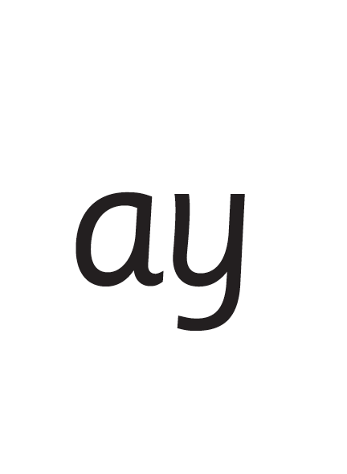
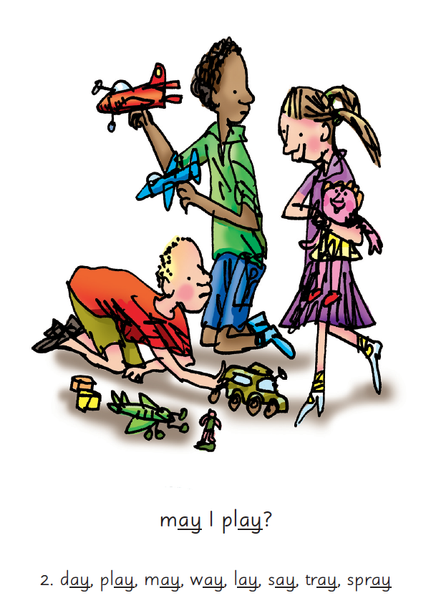

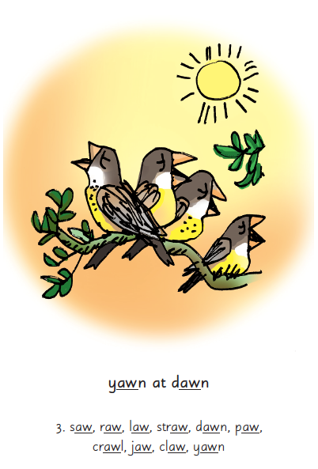
Picture Phrases
Notes:
We use picture phrases to help children remember the Set 2 and Set 3 sounds.
For example, ay, may I play? aw, yawn at dawn

Slide 10
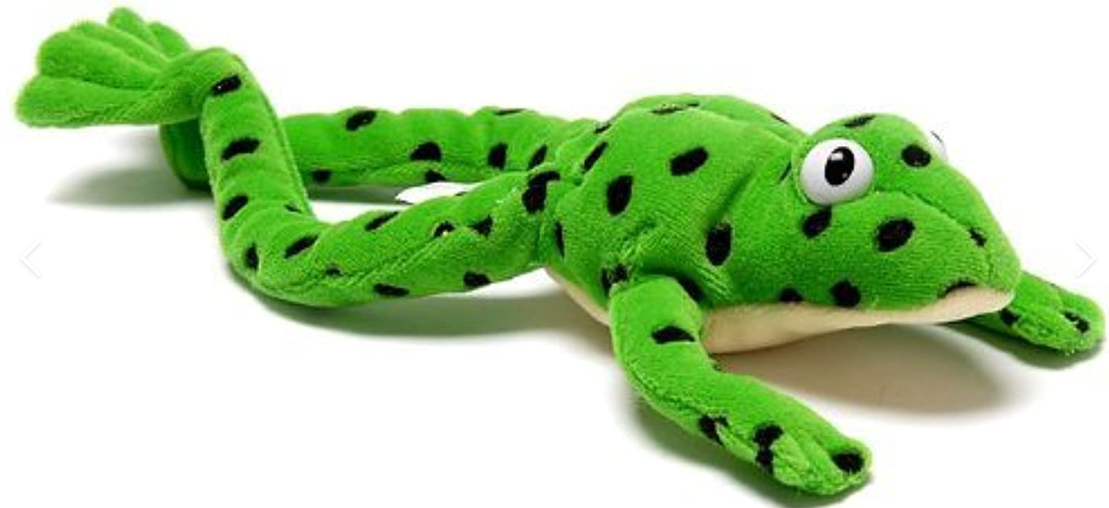
Meet Fred!
Notes:
We use picture phrases to help children remember the Set 2 and Set 3 sounds.
For example, ay, may I play? aw, yawn at dawn

Slide 11


‘Special Friends’, ‘Fred Talk’, read the word
Notes:
Then children practise reading these sounds in words using the routine ‘Special Friends’, ‘Fred Talk’, read the word’.
They spot the ‘Special Friends’ first, then Fred Talk to read the word.
For example, ‘ay’, s-p-r-ay, spray.

Slide 12




Nonsense words
Notes:
Half of the words in the check are real words.
Half are nonsense words. For example, ‘sheb’, ‘glight’, ‘ched’, ‘teb’.
There is a picture of an alien next to each word to remind the children that it isn’t a real word.
Nonsense words check that children will be able to read sounds they know in unfamiliar words.
Children who can read nonsense words will, very soon, be able to read any new word – for example – gargantuan, flailing, raucous, anticipation;
Reading new words increases children’s vocabulary rapidly.

Slide 13
What is the Phonics Screening Check?
A word-reading test at the end of Year 1
Children read 40 words
Notes:
Children complete a word-reading check at the end of Year 1 so that parents can be confident their children are being taught to read successfully.
Children read 40 words. It takes between two and five minutes.
If they do not manage to read 32 of the words, they are given extra support, and repeat the check at the end of Year 2.
It means that all children will be able to read accurately before they begin Year 3.
In our school, we aim to make sure that every child learns to read accurately by the end of Year 1 so they are set up for success in school and in life.
As soon as we spot a child who needs extra practice learning to read sounds and words, we teach them one-to-one for a few minutes every day.

Slide 14
How long will it take to learn to read well?
By the end of year 2 your child should be able to read aloud books that are at the right level for their age.
We would like all children to move onto shared reading lessons by the Summer term of Year 2.

Slide 15
Does it matter if my child misses a lesson or two?
Yes, it matters a lot.
The way we teach your child to read is very organised. If your child misses a few lessons, they may miss learning something they need to know to become a good reader.
Watching the videos at home is key!

Slide 16
What if my child struggles to read?
Flexible groupings and adult one-to-one support
Daily tutoring to keep up!

Slide 17

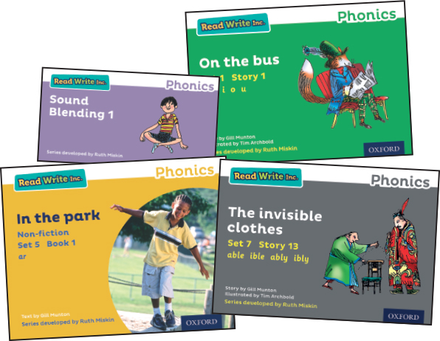
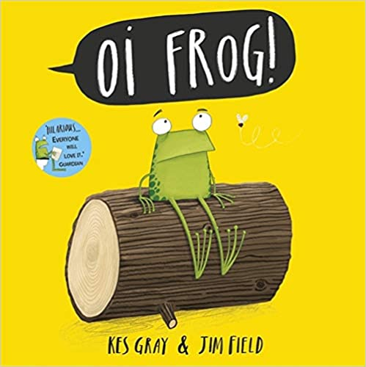

What should my child bring home from school?
Set 1 sounds- Videos sent weekly
Blending books
One new storybook every three days
One ‘choosy book’ once per week

Slide 18

What can I do?
1. Use pure sounds, not letter names
2. Practise the sounds and phrases
3. Practise reading sounds speedily -
‘review, review, review’
4. Use ‘special friends’, ‘Fred talk’, ‘read the word’ to read unfamiliar words
5. Use the handwriting phrases for writing only
Notes:
Show how to use ‘My Set 1 Speed Sounds Book 1’ or cards if you send these home.
You can purchase Set 1 flashcards or My Reading and Writing Kit ages 3-5 early sounds and blending to support your child with Set 1 sounds at home.

Slide 19
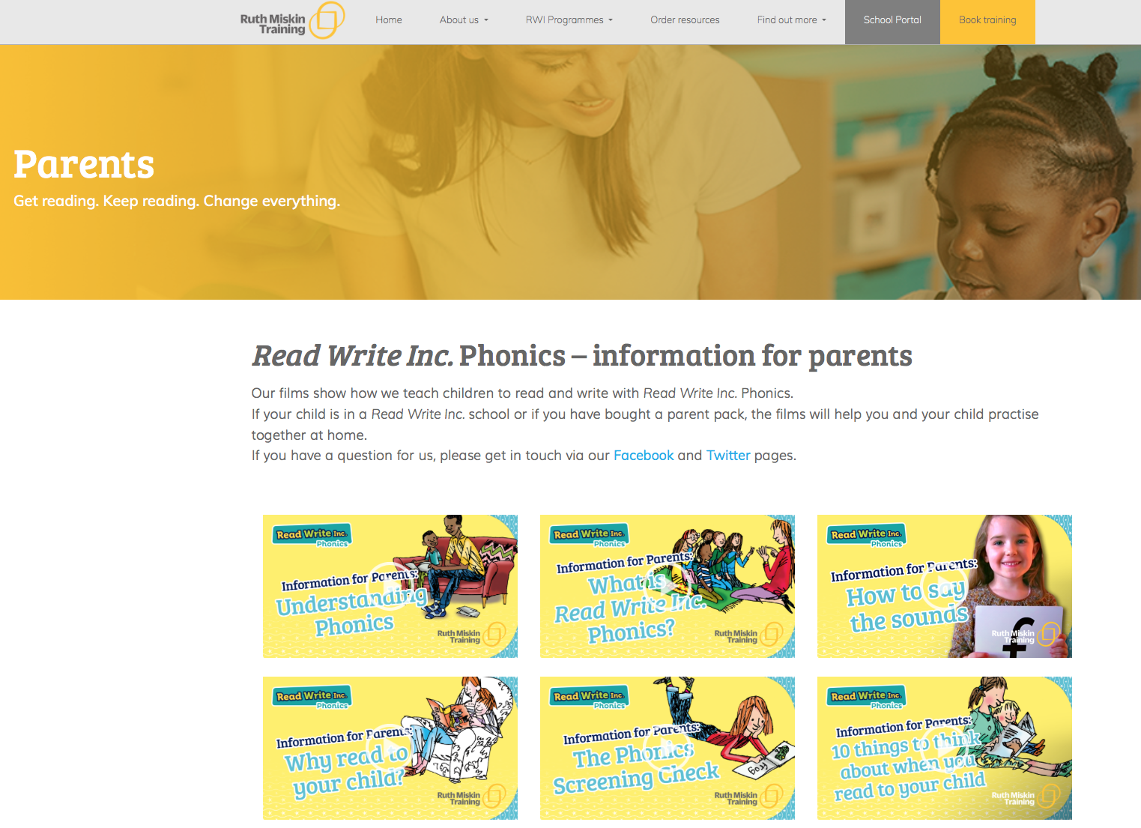
Free Videos
Read Write Inc. (ruthmiskin.com)
Notes:
Watch these video tutorials on the Ruth Miskin website to help you to practise reading and writing with your child at home:
The frieze
reading the stretchy sounds with your child
reading the bouncy sounds with your child
Handwriting
I will also give you a copy of the ‘Reading at Home Booklet 1’.

Slide 20
Any other questions
Q&A

