Slide 1
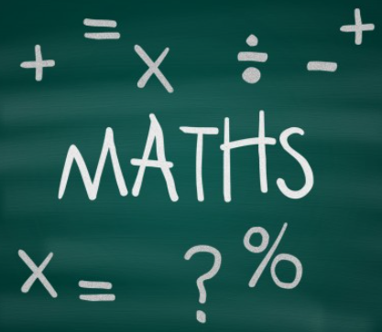
Welcome
Please find a seat and get yourself some squared paper and a pencil.
Aims of session:
- to understand the formal written methods for Year 5 addition, subtraction, multiplication and division
- to know how to support my child at home

Slide 2
Addition with regrouping ones and tens
This is covered in Year 3 and 4 and we revise it at the start of the year:
6
4
+
7
7
1
4
1
1
1

Slide 3
Addition Regrouping ones and tens
Sometimes the ones or tens digits add to 10
2
8
9
+
2
7
1
5
6
0
1
1

Slide 4
Problem solving with regrouping
Calculate the missing digits.
a)
1
6
b)
2
7
c)
1
9
+
1
4
+
1
2
+
6
3
1
1
4
5
0
7
6
2
1
1
1
1
1
1
___ + ___ = 311
___ + ___ = 450
___ + ___ = 762

Slide 5
Subtraction regrouping in the ones or tens
The children will have learnt column subtraction in Year 3 and 4.
2
1
3
5
5
355 − 173 = 182
−
1
7
3
1
8
2

Slide 6
Regrouping in the ones and tens
Use each number once to complete all three column subtractions.
615
344
368
249
702
733
a)
b)
c)
−
−
−
3
6
6
3
6
5
3
5
8

Slide 7

Understanding 3 digit x 1 digit
3 digit x 1 digit.
324 x 2 =
3
2
4
×
2
6
4
8

Slide 8


Regrouping in long multiplication
Long multiplication can be used to calculate the product.
First multiply by the ones.
2
2
165 × 2
 | 1 | 6 | 5
 |  | 4 | 2 | ×
 | 3 | 3 | 0
6 | 6 | 0 | 0 | +
6 | 9 | 3 | 0
1
1
Then multiply by the tens.
165 × 40
Now, sum the partial products.
There are 6,930 table tennis balls altogether.
What did you notice?
Notes:
You had to regroup from the hundreds to the thousands.

Slide 9

Regrouping in long multiplication
Sam, Andeep and Aisha are solving 232 × 42
Who is correct? Justify your thinking to your partner.
Sam’s calculation
Andeep’s calculation
1
 | 2 | 3 | 2
 |  | 4 | 2 | ×
 | 4 | 6 | 4
9 | 2 | 8 | 0 | +
9 | 7 | 4 | 4
 | 2 | 3 | 2
 |  | 4 | 2 | ×
 | 4 | 6 | 4
9 | 1 | 8 | 0 | +
9 | 4 | 1 | 4
1
Andeep is correct. He has regrouped correctly.

Slide 10
Multiple regroupings
My turn: 2,876 × 22
Your turn: 3,128 × 29
1
 | 3 | 1 | 2 | 8
 |  |  | 2 | 9 | ×
2 | 8 | 1 | 5 | 2
6 | 2 | 5 | 6 | 0 | +
9 | 0 | 7 | 1 | 2
 | 2 | 8 | 7 | 6
 |  |  | 2 | 2 | ×
 | 5 | 7 | 5 | 2
5 | 7 | 5 | 2 | 0 | +
6 | 3 | 2 | 7 | 2
1
1
1
1
2
7
1
1
1
1
1
1
1

Slide 11
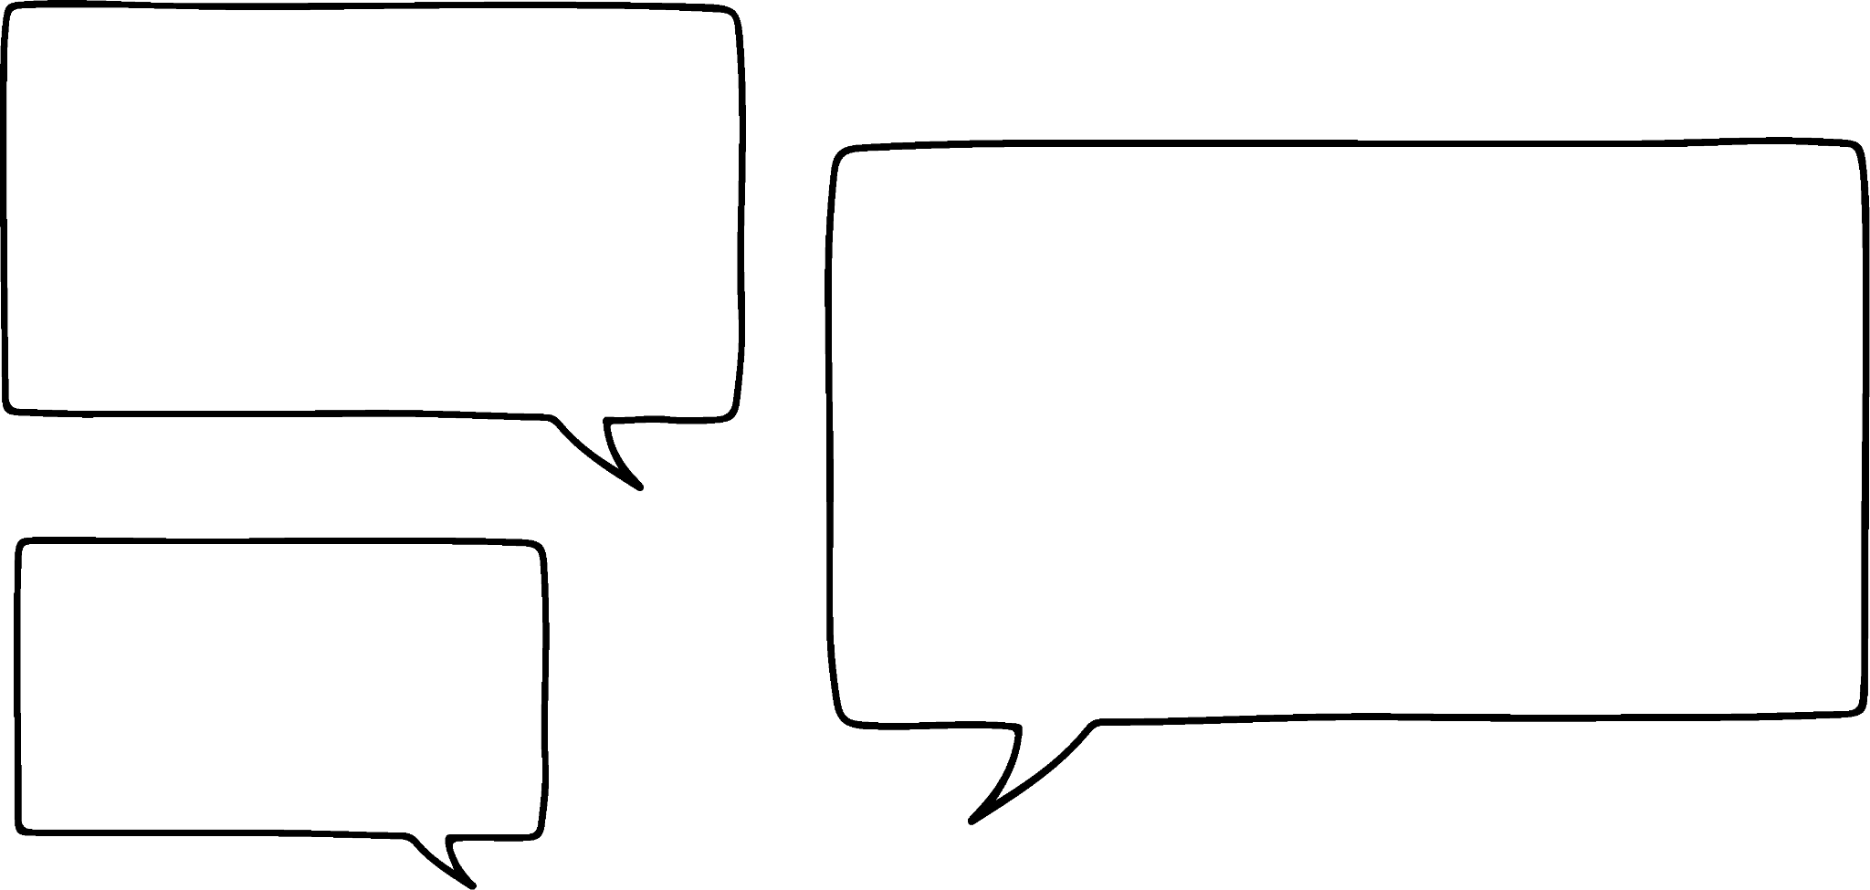
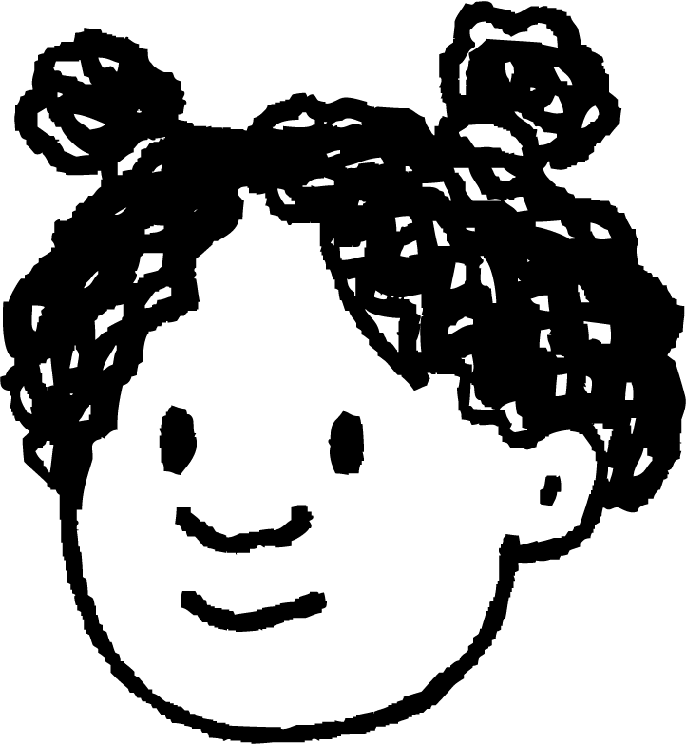


Division Record regrouping and remainders in short division
553 ÷ 4 =
I know how to divide a 2-digit number using short division, but what do I do when it’s a 3 digit number?
4 | 5 | 5 | 3
100s 10s 1s

Slide 12

Record regrouping and remainders in short division
A bakery sells desserts in packs of 4. How many packs are required to pack 533 desserts? Will there be any desserts left over?
100s 10s 1s
 | 1 | 3 | 3
4
r 1
4 | 5 | 3 | 3
1
3
3
r 1
10
10
1
1
100
1
1
10
10
1
1
100
10
10
1
1
10
10
1
1
100
10
1
533 ÷ 4 =
133
r 1
10
1
100
1
10
100
10
1
10
1

Slide 13
Use short division (including remainders)
4) Fill in the missing digits.
 | 1 | 4 | 6 | r1
3 | 4 | 3 | 9
 | 1 | 8 | 6 | r1
5 | 9 | 3 | 1
 | 1 | 4 | 9 | r3
6 | 8 | 9 | 7
 | 0 | 2 | 9 | r5
8 | 2 | 3 | 7
1
1
4
3
2
5
2
7

Slide 14

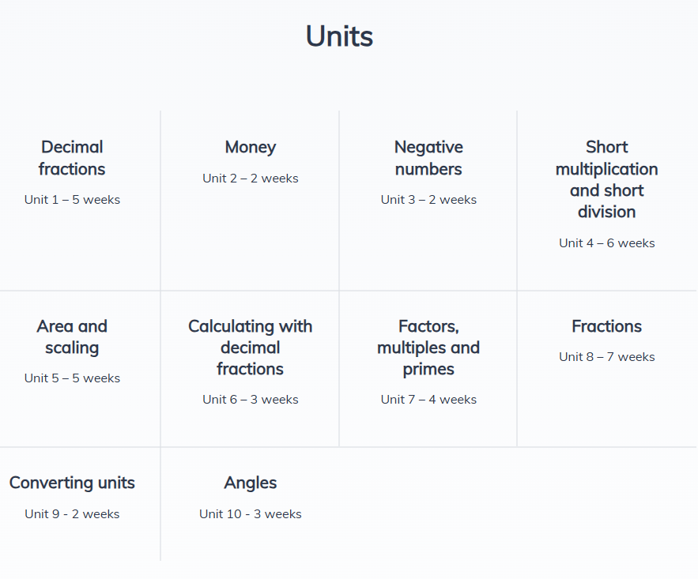
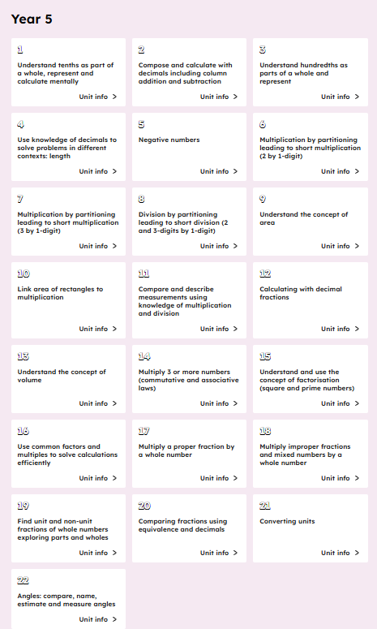


Slide 15

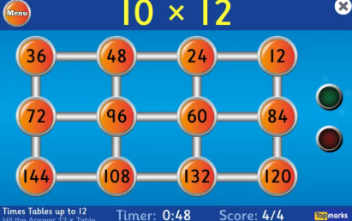
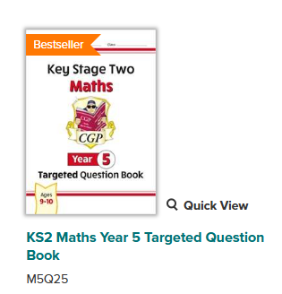
How you can help your child in maths:
First – make sure they know their times tables
TTRS
Then – ensure number bonds are secure.
Hit the button
Next – see the maths in life
Practical Kitchen Maths
Telling Time
Real-World Money & Percentages
Standard Deck Card Games - Math War: A versatile game for 2 players. Each player flips over two cards and performs an operation (addition, subtraction, multiplication, or division). The player with the highest total (the "sum" or "product") wins the round.

Slide 16
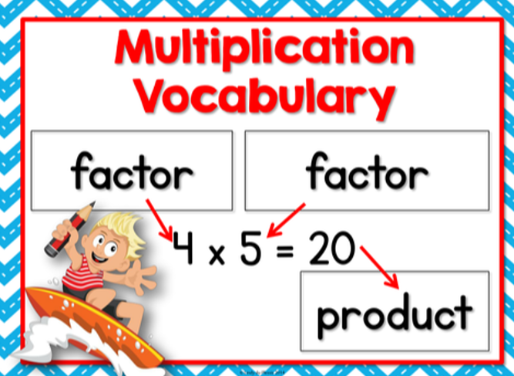
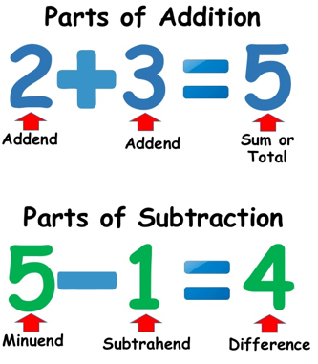
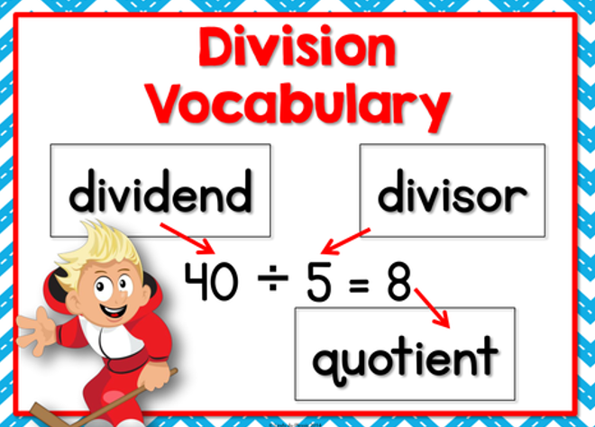
Key vocabulary

